Slide 1
Calling a Function
ELEC1006: ENGINEERING COMPUTING

Slide 2

Calling a Function
To call a function, use the function name followed by () and ;
printHeading();
When a function is called, a program executes the body of the called function.
After the function terminates, execution resumes in the calling function at the point of call.
PAGE 2

Slide 3
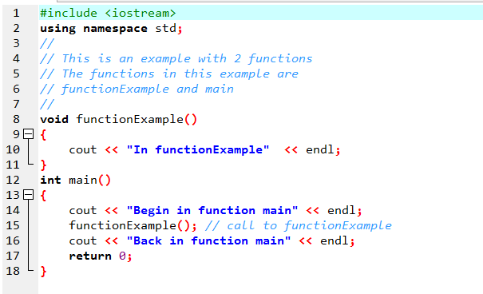
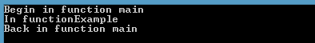
Example
PAGE 3

Slide 4
Flow Control in Example
PAGE 4

Slide 5
Calling Functions
main can call any number of functions.
Functions can call other functions.
int main()
{
func1(); // Call func1()
}
void func1()
{
func2(); // Call func2()
}
PAGE 5

Slide 6
More info
[1] cplusplus.com: Functions
https://cplusplus.com/doc/tutorial/functions/
[2] learncpp.com: 2.1 – Introduction to Functions
https://www.learncpp.com/cpp-tutorial/introduction-to- functions/
PAGE 6

